Slide 1
DATA SCIENCE

Slide 2
How Much Data Do We have ?
Google processes 20 PB a day (2008)
Facebook has 60 TB of daily logs
eBay has 6.5 PB of user data + 50 TB/day (5/2009)
1000 genomes project: 200 TB
Cost of 1 TB of disk: $35
Time to read 1 TB disk: 3 hrs

Slide 3
Lots of data is being collected and warehoused
Web data, e-commerce
Financial transactions, bank/credit transactions
Online trading and purchasing
Social Network

Slide 4
any data that is expensive to manage and hard to extract value from
01
02
03
Volume
Velocity
Complexity
The size of the data
The latency of data processing relative to the growing demand for interactivity
the diversity of sources, formats, quality, structures.

Slide 5
Types of Data We Have
Relational Data (Tables/Transaction/Legacy Data)
Text Data (Web)
Semi-structured Data (XML)
Graph Data
Social Network, Semantic Web (RDF), …
Streaming Data

Slide 6
What To Do With These Data?
MARS
VENUS
Aggregation and Statistics
Data warehousing and OLAP
Indexing, Searching, and Querying
Keyword based search
Pattern matching (XML/RDF)
Knowledge discovery
Data Mining
Statistical Modeling

Slide 7
OUR SOLUTIONS
MARS
NEPTUNE
The U.S. will need 140,000-190,000 predictive analysts and 1.5 million managers/analysts by 2018
the next 10 years will be Data Analysist,”

Slide 8
What is Data Science?
An area that manages, manipulates, extracts, and interprets knowledge from tremendous amount of data
Data science (DS) is a multidisciplinary field of study with goal to address the challenges in big data

Slide 9
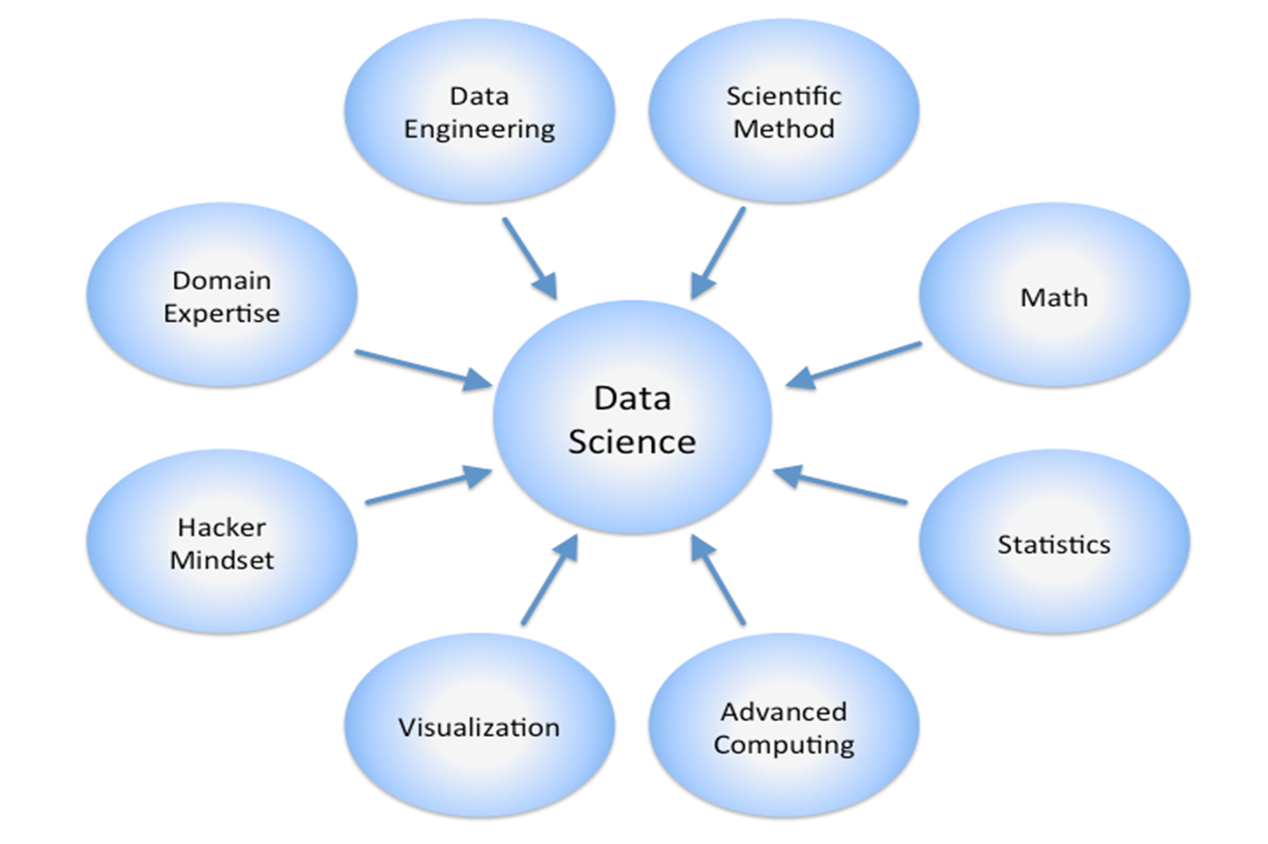
COMPANY

Slide 10
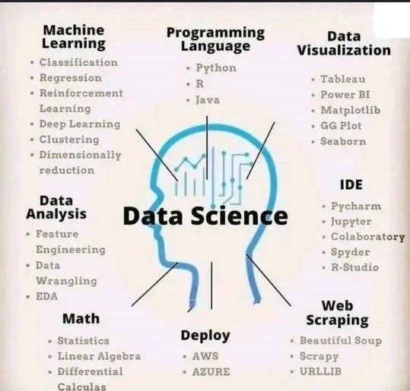

Slide 11
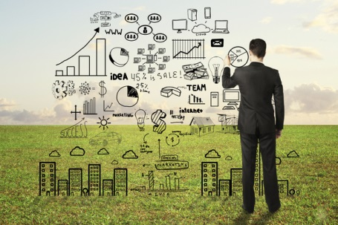
Data Scientist The Sexiest Job of the 21st Century They find stories, extract knowledge. They are not reporters
AGE
20-39
80%
40-60
50%
75%
500,000+
Employees
60%

Slide 12

Data scientists are the key to realizing the opportunities presented by big data. They bring structure to it, find compelling patterns in it, and advise executives on the implications for products, processes, and decisions

Slide 13
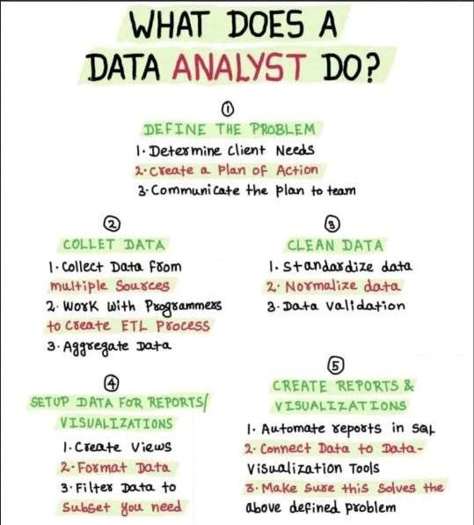

Slide 14


HELENA PATTERSON
JANE DOE
Companies learn your secrets, shopping patterns, and preferences
For example, can we know if a woman is pregnant, even if she doesn’t want us to know
Data Science and election (2008, 2012)
1 million people installed the Obama Facebook app that gave access to info on “friends”

